Slide 1
Midterm on Friday at 2 pm

Slide 2
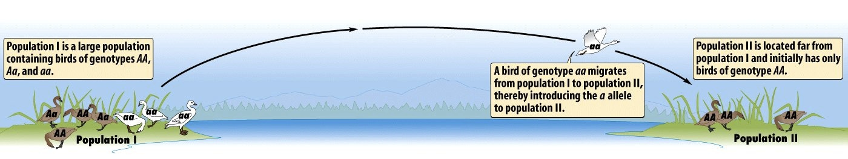
Gene flow
Consists of “flow” of alleles between populations due to movement of fertile individuals (or gametes, e.g. in pollen)
Causes populations to have more similar gene pools (can benefit pop. , but also sometimes be maladaptive)

Slide 3
Genetic Drift
Random changes in allele frequencies within populations which result from chance variation in individual survival and reproduction
Most important in small populations
Changes can be neutral, maladaptive, or adaptive

Slide 4
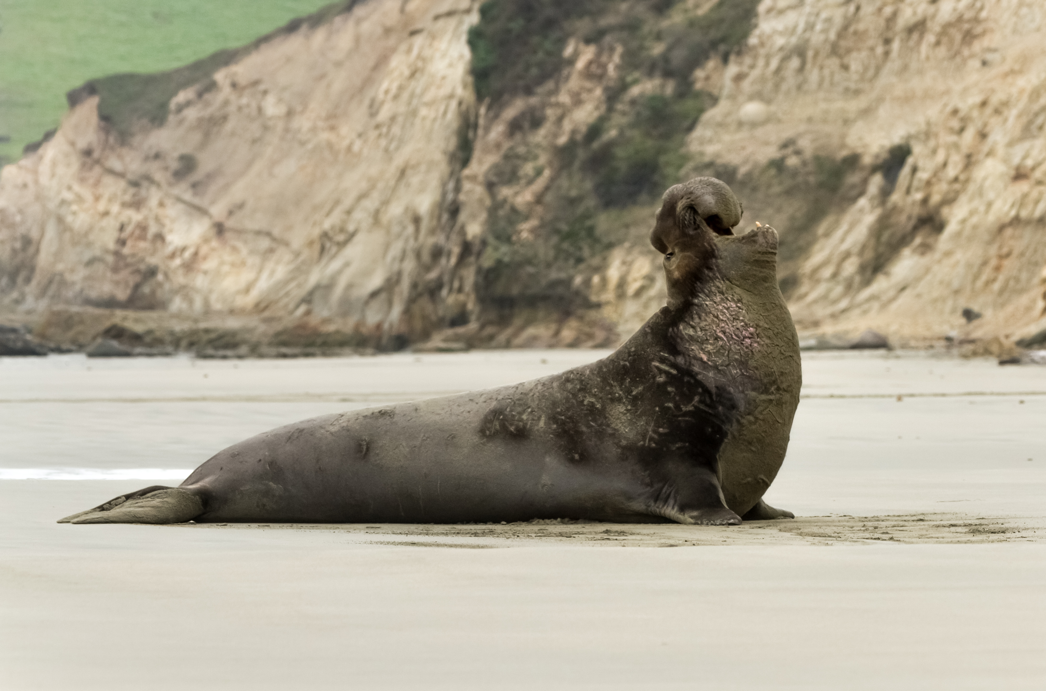
Genetic drift: Bottleneck effect (happens at near-extinction events)
Dramatic decrease of population size leaves only part of the genetic variation
Example: Northern elephant seals

Slide 5
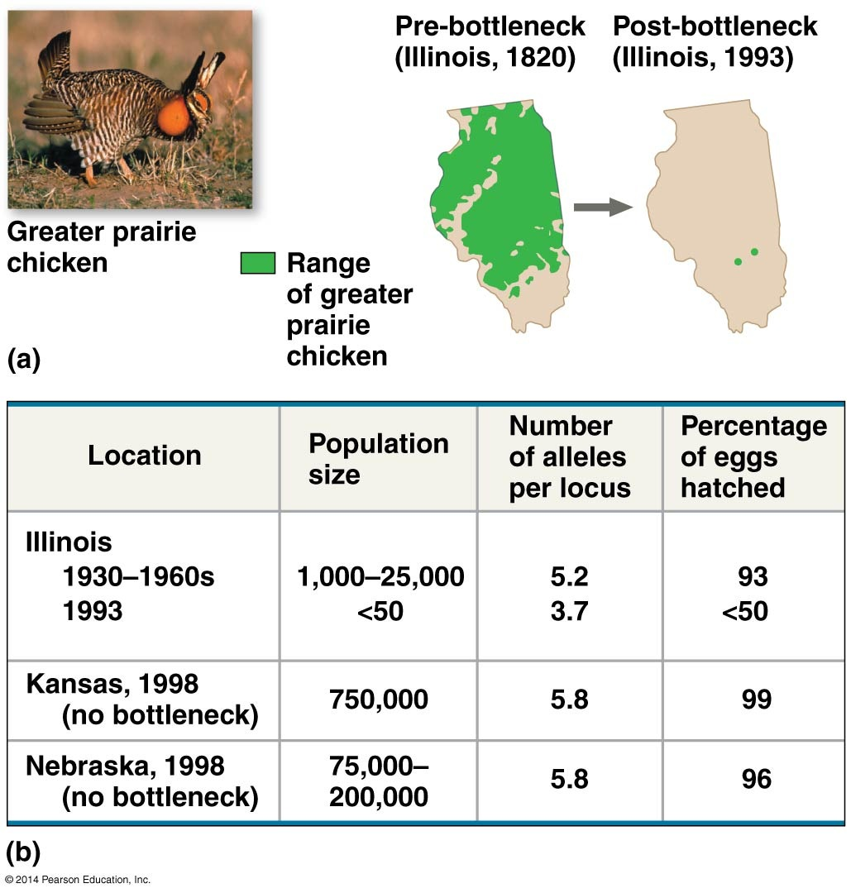

Slide 6
Genetic drift : Founder effect (happens at dispersion events)
Dispersion to small founder population can lead to random differences in allele frequencies
Mainland population gene pool
Island population
gene pool

Slide 7
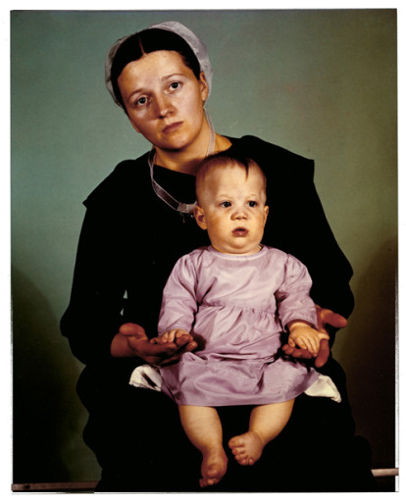
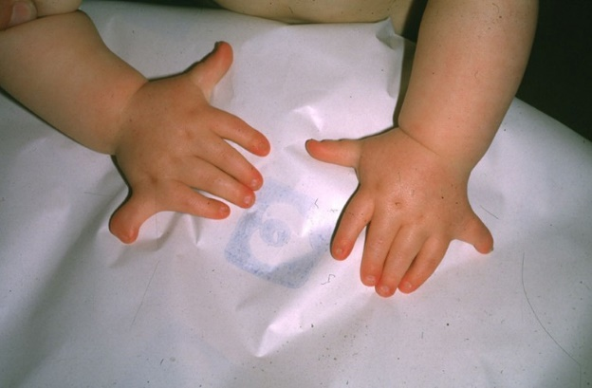
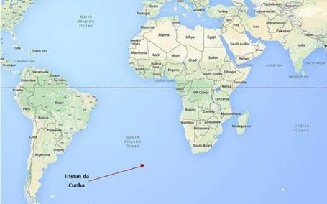
Genetic drift: Founder effect examples
Amish – small founder population – EVC syndrome (Ellis Van Creveld); polydactyl, short-limb dwarfism
Descendants of British colonizers of Tristan da Cunha – retinitis pigmentosa; blindness

Slide 8
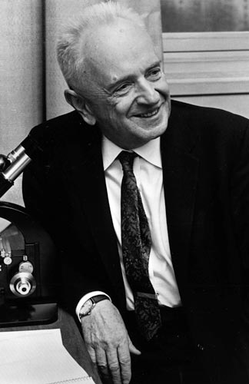
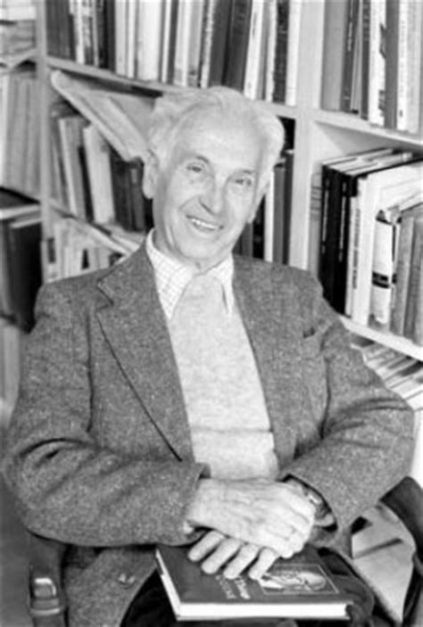
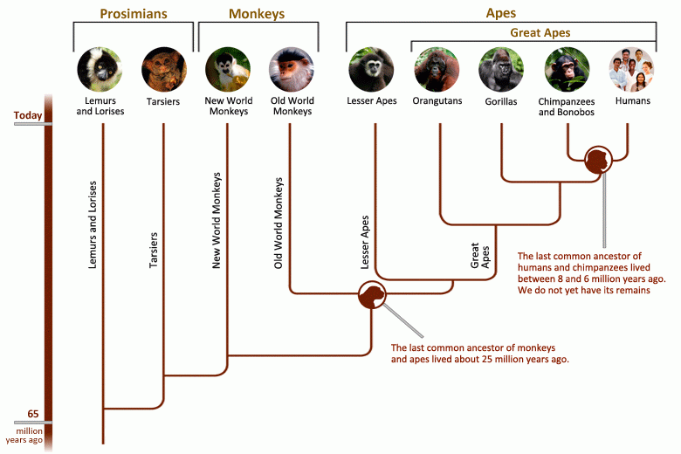
The Modern Synthesis
First half of the 20th century e.g. Ernst Mayr and Theodosius Dobzhansky
Natural selection combined with genetics, particularly Mendel’s inheritance laws (also DNA transcription, plus paleontology , speciation, and phylogenetics)
Dobzhansky 1900-1975
Mayr 1904-2005

Slide 9
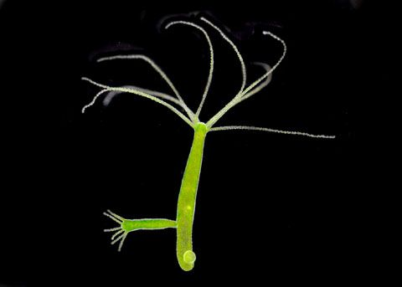
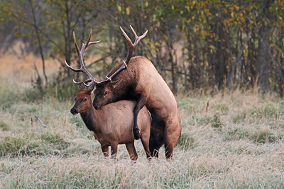
Sexual reproduction and sexual selection
Microorganisms typically reproduce through simple mitosis, some asexual reproduction (multicellular) happens by budding – offspring are clones
Sexual reproduction is more common in complex organisms (most vertebrates, all mammals), many plants can reproduce both asexually and sexually.

Slide 10
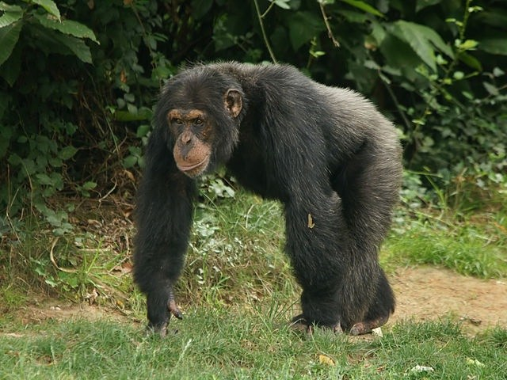
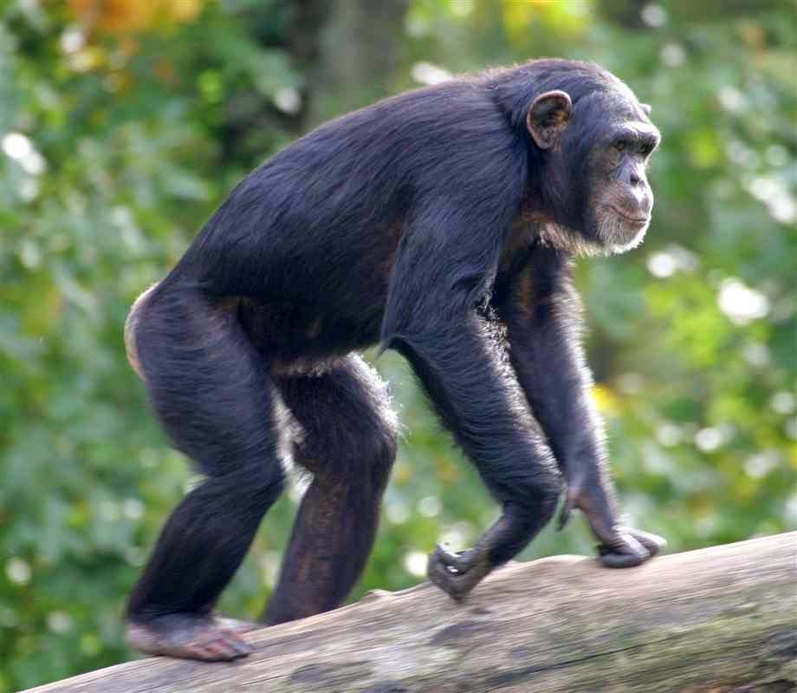
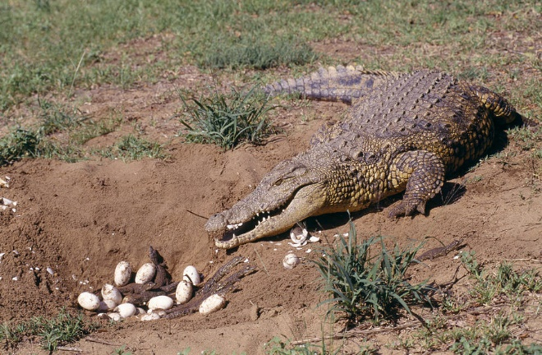
Defining Biological Sex?

Slide 11
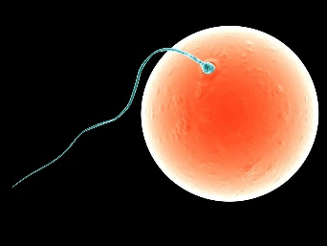
Defining Biological Sex?
In biology, defined by having gonads that can produce eggs (ovary, female) or sperm (testis, male)
In mammals males always have XY chromosomes, while females have XX
There is an enormous amount of variation in other animals and plants (e.g. birds: females XY; crocodiles: temperature, not chromosomes)

Slide 12
Inheritance of sex-linked genes
Sex is determined by X and Y chromosomes in all mammals (XY=male, XX=female)
The mammalian sex chromosomes have genes for many characters unrelated to sex (e.g. color blindness vs normal color vision)
A gene located on either sex chromosome is called a sex-linked gene (Sex-linked genes follow specific patterns of inheritance)

Slide 13
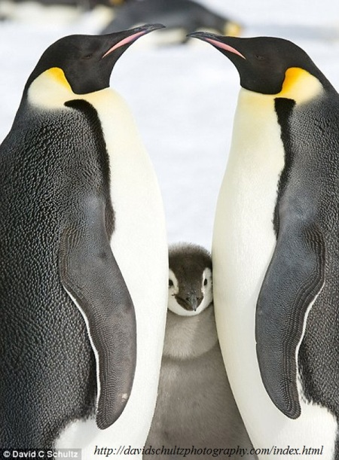
Expense of Sexual Reproduction
Find mate, sometimes facing competition
Assess mate potential -Both sexes have to show signs of sexual maturity and fertility
So why do it?

Slide 14
Expense of Sexual Reproduction
Find mate, sometimes facing competition
Assess mate potential -Both sexes have to show signs of sexual maturity and fertility
Increase genetic variation among offspring

Slide 15
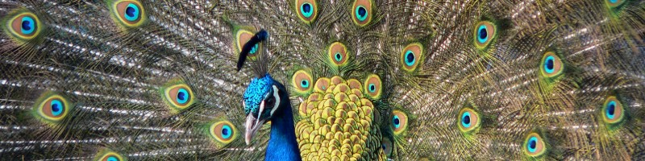
Sexual selection (non-random mating)
Discussed by Darwin, who identified two components
-competition within one sex for access to the other - intrasexual selection
-mate choice - intersexual selection
Often leading to strong sexual dimorphism

Slide 16
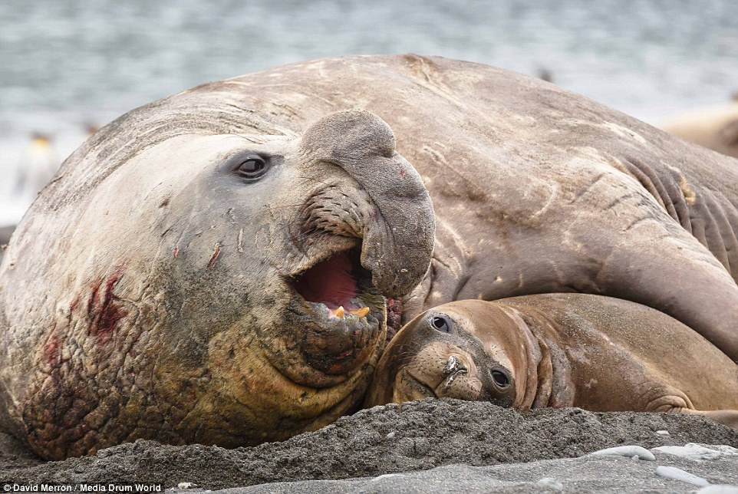
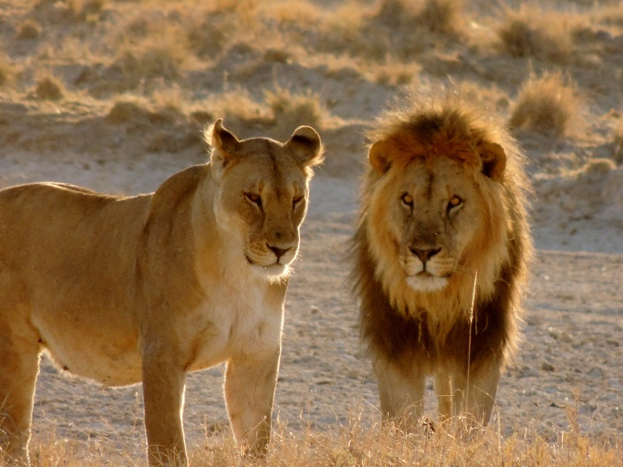
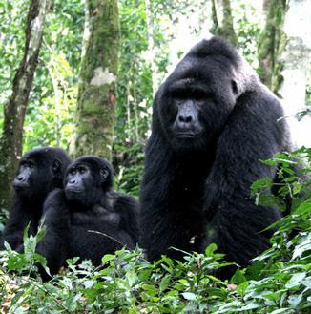
Sexual selection can result in pronounced sexual dimorphism
Examples of sexual dimorphism in mammals

Slide 17
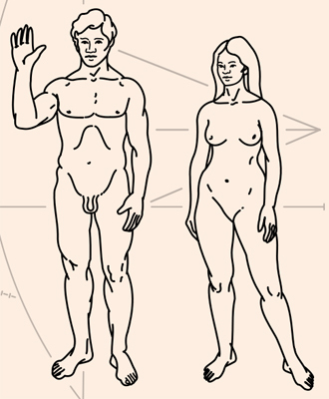
Sexual selection
Why are men larger than women?

Slide 18
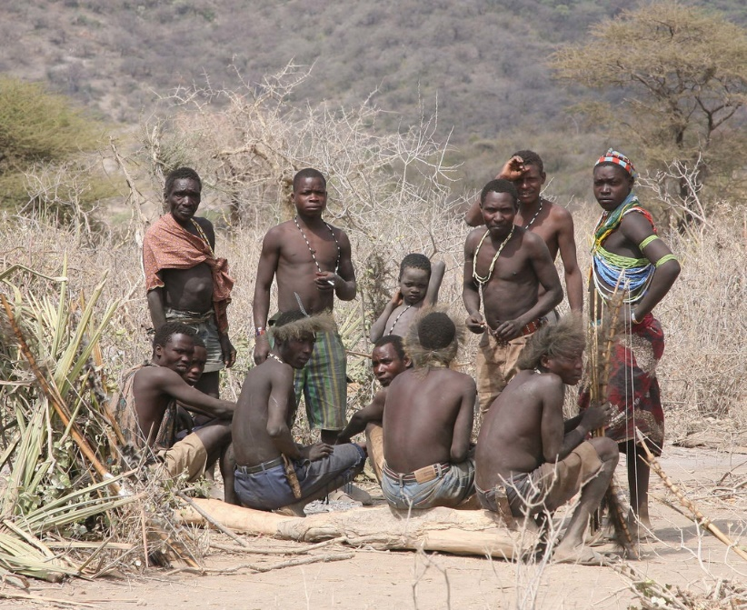
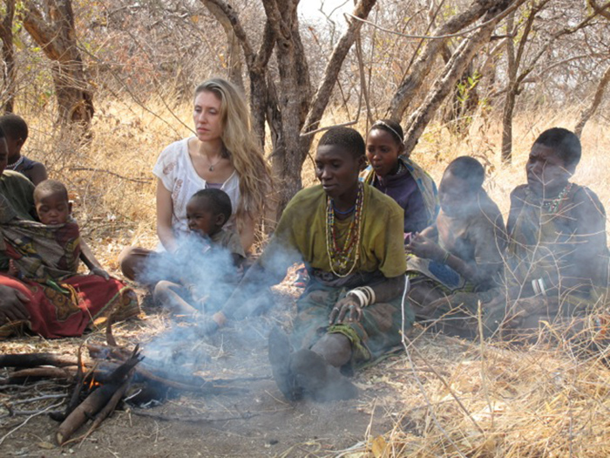
Sexual dimorphism in humans
Why are men larger than women?
Hadza, hunter-gatherers Tanzania
-Most common reason for murder: men fighting over women
-Women also tend to prefer men who are larger than themselves

Slide 19
Intro to population genetics
How do alleles and genotypes behave in whole populations?

Slide 20
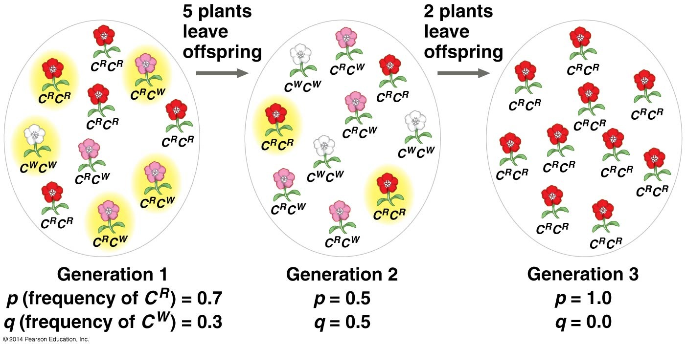
Gene pool
A concept denoting the entire genetic makeup of a population i.e. all the alleles present in an interbreeding population
If only one allele is present, this is allele said to be fixed (this can happen by natural selection, or genetic drift)
fixed

Slide 21
Intro to population genetics
Genotype frequency: the frequency of individuals with a specific genotype (e.g. homozygous for white C^{w}C^{w})
Allele frequency: the number of copies of one specific allele divided by number of copies of all alleles in that population (for that gene, remember two copies for each individual)
Allele frequencies in a population; typically denoted by lowercase letters (e.g. alleles C^{R}, C^{w} could have allele frequencies p, q)
If there are only two alleles present, then p+q = 1 (100%)
If there is only one allele for a given locus, then it is said to be fixed (e.g. if all individuals are white C^{w}C^{w})

Slide 22


Intro to population genetics
E.g. a population of 100 plants has two alleles for flower color, C^{w} and C^{R}. 10 individuals are homozygous for white, 20 are heterozygous C^{w}C^{R} (if pink, what kind of dominance?), and 70 are homozygous red.
Number of white alleles: (10x2) + (1x20) = 40. Allele frequency: q= 40 / 2x100 = 0.2
Red allele frequency: p= 1- 0.2 = 0.8

Slide 23
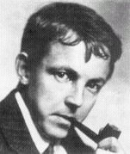
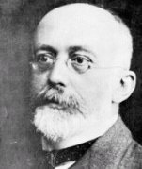
Intro to the Hardy Weinberg principle
Population = a localized group of interbreeding individuals of the same species
Hardy and Weinberg studied the allele frequencies in stable populations

Slide 24
Hardy Weinberg principle
Given a series of assumptions, allele frequencies and genotype frequencies in a population will not change between generations, and genotype frequencies follow a set pattern
p² + 2pq + q² = 1

